Slide 1
Five Number Summary Interquartile Range and Outliers
Year 11 Mathematics Essentials

Slide 2
Lesson OutComes
2.1.9 Calculate and interpret quartiles
2.1.16 complete a five number summary for different data sets
2.1.17 construct and interpret box plots using a five number summary

Slide 3
24
7
30
Topic: Five Number Summary
Date: /07/2018
EQ – How do we interpret a box and whisker plot?
From our previous lesson, a box and whisker plot is a visual display of a 5 number summary of a set of data
This means that we can interpret and analyse the information displayed in a box and whisker plot
Lower Quartile
(Q1)
Upper Quartile (Q3)
Lowest Value
Median
Highest Value
Whisker
Box
Whisker
4
5
6
7
8
9
10
11
12

Slide 4
24
7
30
Topic: Five Number Summary
Date: /07/2018
EQ – How do we interpret a box and whisker plot?
What is the interquartile range?
Interquartile Range, (IQR) – the difference between the upper and lower quartile of a set of data.
IQR = Upper Quartile – Lower Quartile
A small interquartile range means that the data is close together
A large interquartile range means that the data is spread out.
Interquartile range

Slide 5

From the Previous Lesson…
Lower Quartile
Median
Upper Quartile
Lower Extreme
3
1
2
Upper Extreme
4
5
14 – 8.5 =
5.5

Slide 6
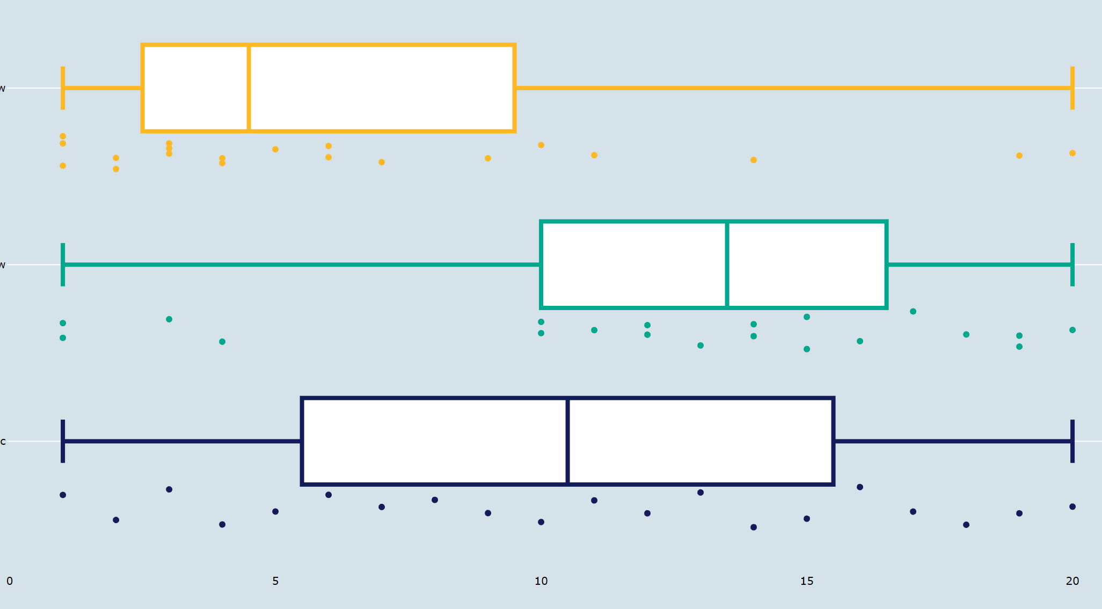
24
7
30
Topic: Five Number Summary
Date: /07/2018
EQ – How do we interpret a box and whisker plot?
What do skewed box and whisker plots look like?
Positively Skewed
Negatively Skewed
What does a symmetrical box and whisker plot look like?
Symmetrical
Source: https://plot.ly/~ColleenYoung/138/box-plots-skew/#/

Slide 7
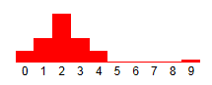
24
7
30
Topic: Five Number Summary
Date: /07/2018
EQ – How do we interpret a box and whisker plot?
What is an outlier?
An outlier is an extremely high or an extremely low value in a data set.
We can identify an outlier if it is:
Greater than Q₃ + 1.5 × IQR or
Less than Q₁ - 1.5 × IQR
The graph below shows a distribution of a set of data with an extreme value of 9.

Slide 8
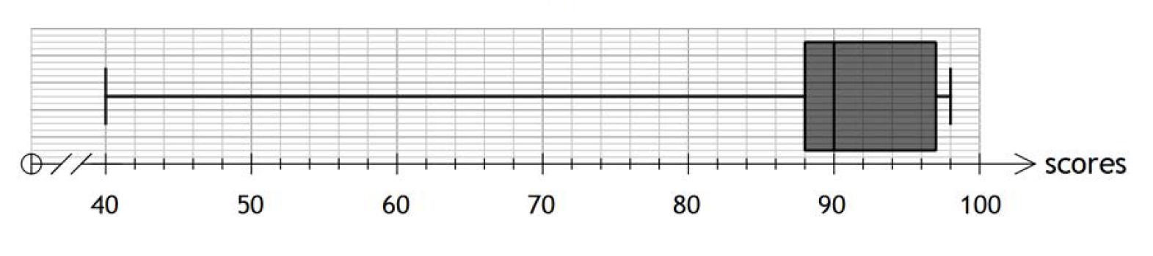
24
7
30
Topic: Five Number Summary
Date: /07/2018
EQ – How do we interpret a box and whisker plot?
How do we tell whether a value is an outlier?
For the following box and whisker plot determine
the 5 number summary
Interquartile range
Identify any outliers in the data set.
Steps
Min = 40 1.5 × IQR = 1.5 × 9 Q1 = 88 = 13.5 Median or Q2 = 90 Q3 + 13.5 = 97 + 13.5 Q3 = 97 = 110.5 Q4 = 98 Q1 – 13.5 = 88 – 13.5
IQR = Q3 – Q1 = 74.5 = 97 – 88 Values greater than 110.5 = 9 and less than 74.5 are
outliers. This means that
40 is an outlier.
Notes:
Stand Up, Hands Up, Pair Up, or Think Pair Share: Allow students to discuss the maths that has occurred to write out the steps taken in the example to determine the outlier value.
Write down a class set of steps in the Steps column

Slide 9


Slide 10
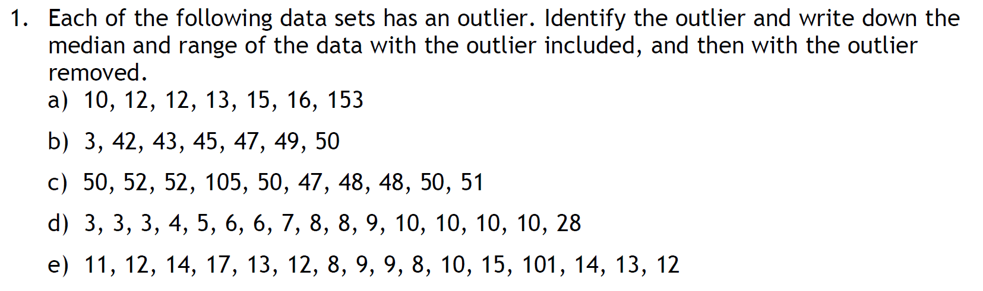
Task

Slide 11
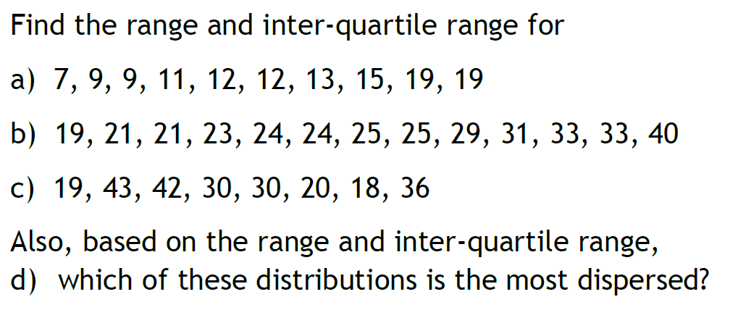
Task

Slide 12
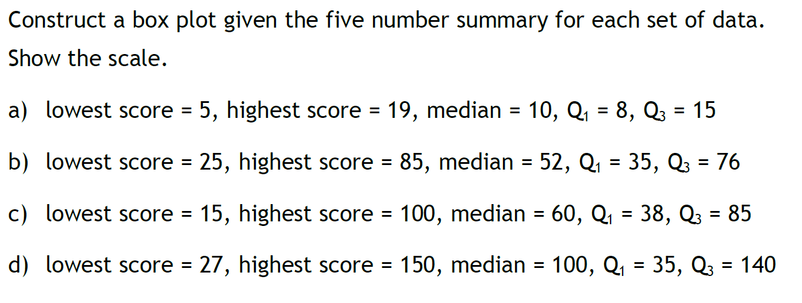
Task

Slide 13
